Slide 1



ABS Hospital -Medical Assistance Application
Under the guidance of Dr Vijaya Shetty S
KUMUDA K – 1NT18CS082
RITIKA SUBUDHI-1NT18CS133
SHEETAL S HARSHINI- 1NT18CS149
SHREYA A HEGDE-1NT18CS153
ALWAYS BY YOUR SIDE

Slide 2
PROBLEM STATEMENT
In the present system one has to call the clinic to book an appointment because many small hospitals do not have an online appointment booking system. This is a very bothersome task.
Also the constant fear of misplacing the reports is another major problem for every patient.
Why not create a system that serves this purpose?

Slide 3
OBJECTIVES
Digitalize the appointment booking system
Reduce manual effort and paper work
Avoid confusions related to doctor’s timings and availability
Organize all the reports and prescriptions in one place, this reduces the hassle of carrying your reports everywhere and also one doesn’t have to worry about misplacing the reports.

Slide 4
HARDWARE AND SOFTWARE REQUIREMENTS
The project is developed using Eclipse IDE is coded in java
We have used
JAVA FX for the GUI
JDBC connector and MySQL for the database

Slide 5
IMPLEMENTATION DETAILS
The project has the following pages:
Login Page
Sign Up page
Home page
Appointment Page
Edit Profile Page
Show Reports
Show Prescriptions
Also contains a database ABS_Hospital that has 5 tables
Login_Credentials
Patient_Details
Report
Prescription
appointment

Slide 6
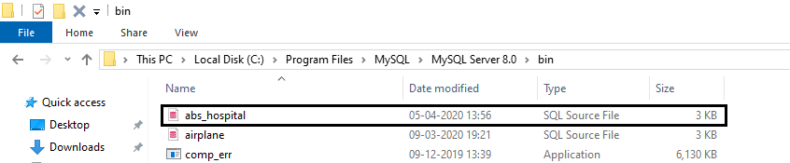
IMPLEMENTATION DETAILS STEPS TO RUN THE PROJECT
To run the javafx code:
1)Create package with name “Application”.
2)Create a class with name “abs_hospiatal”.
3)Copy and paste respective code in the above mentioned classes.
To run the sql file:
1)Copy and paste abs_hospital.sql file in the mentioned folder:
My Computer>Local Disk C>Program Files>MySQL>MySQL Server 8.0>bin

Slide 7

IMPLEMENTATION DETAILS STEPS TO RUN THE PROJECT
2)To run abs_hospital.sql ,use command “source abs_hospital.sql; “ on my sql command-line client.

Slide 8
OOP’s PRINCIPLES USED AND THEIR CORRELATION TO PRACTICAL IMPLEMENTATION
Encapsulation:-The whole idea behind encapsulation is to hide the implementation details from users. If a data member is private it means it can only be accessed within the same class. No outside class can access private data member (variable) of other class.
In our project we have used encapsulation concept in class ”ABS_Hospital”.

Slide 9
OOP’s PRINCIPLES USED AND THEIR CORRELATION TO PRACTICAL IMPLEMENTATION
Inheritance:-Inheritance can be defined as the process where one class acquires the properties (methods and fields) of another. With the use of inheritance the information is made manageable in a hierarchical order.
The class which inherits the properties of other is known as subclass (derived class, child class) and the class whose properties are inherited is known as superclass (base class, parent class).
In our program ABS_Hospital extends Application class.

Slide 10
OOP’s PRINCIPLES USED AND THEIR CORRELATION TO PRACTICAL IMPLEMENTATION
Polymorphism:-means one name many forms. In Java, polymorphism can be achieved by method overloading and method overriding.
In the project we have used predefined interfaces like Observable list.

Slide 11

RESULTS

Slide 12

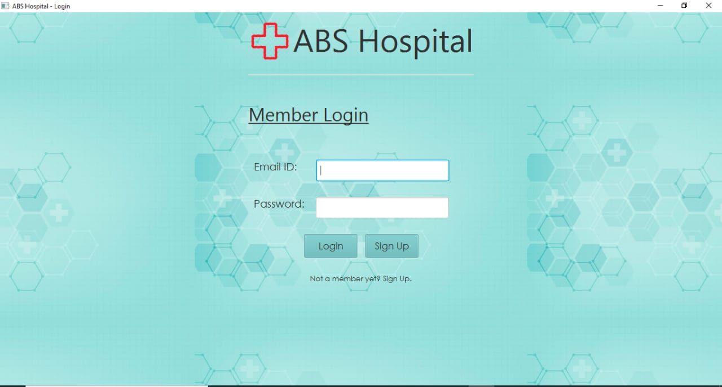
LOGIN PAGE

Slide 13
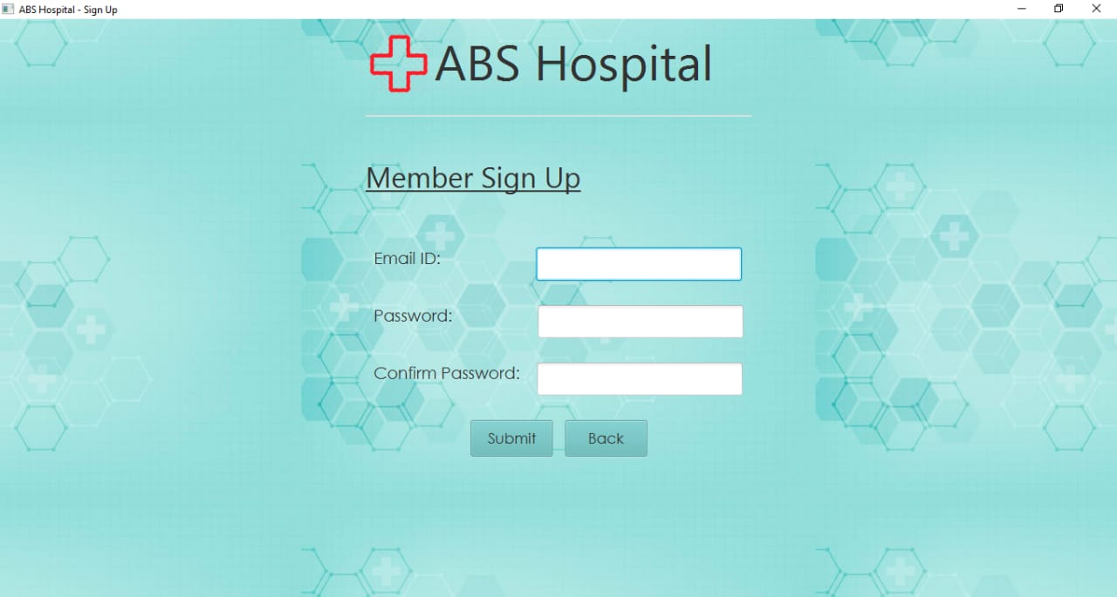
SIGN UP PAGE

Slide 14
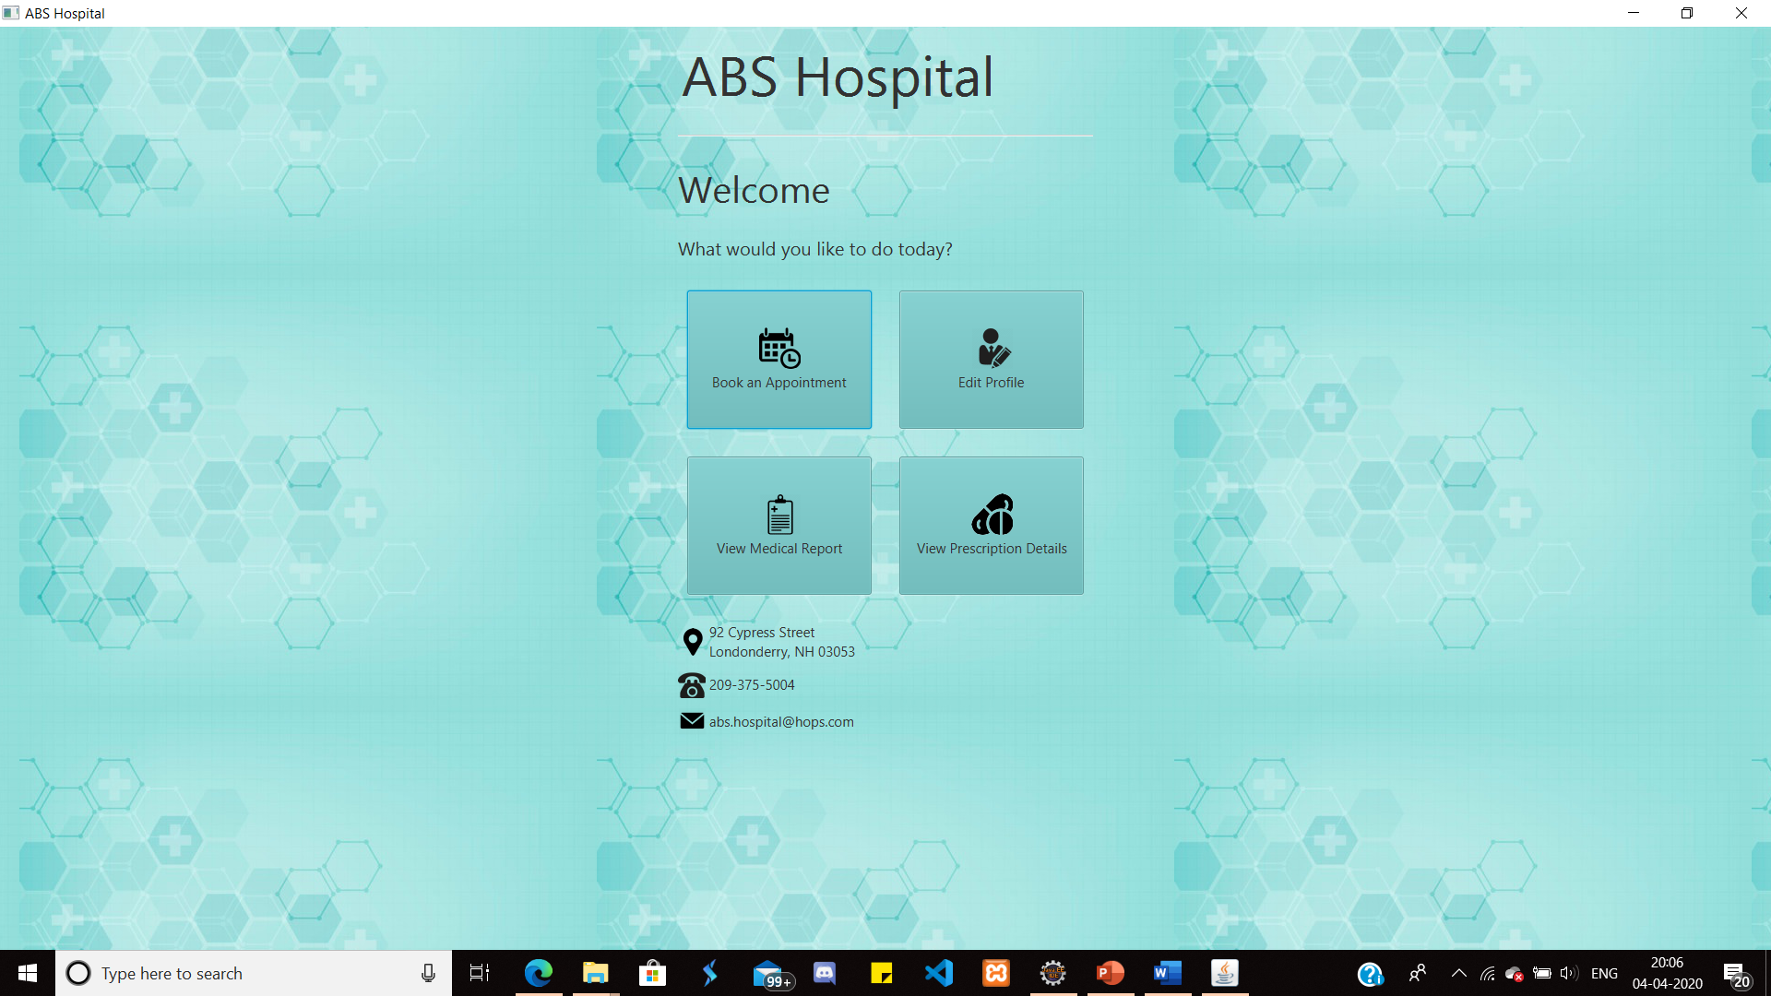
HOME PAGE

Slide 15
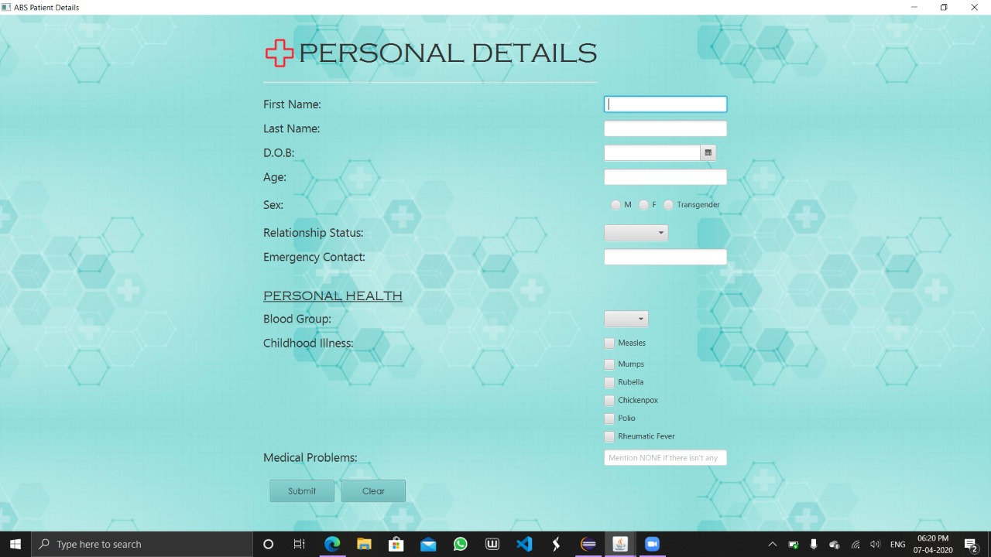
EDIT PROFILE

Slide 16
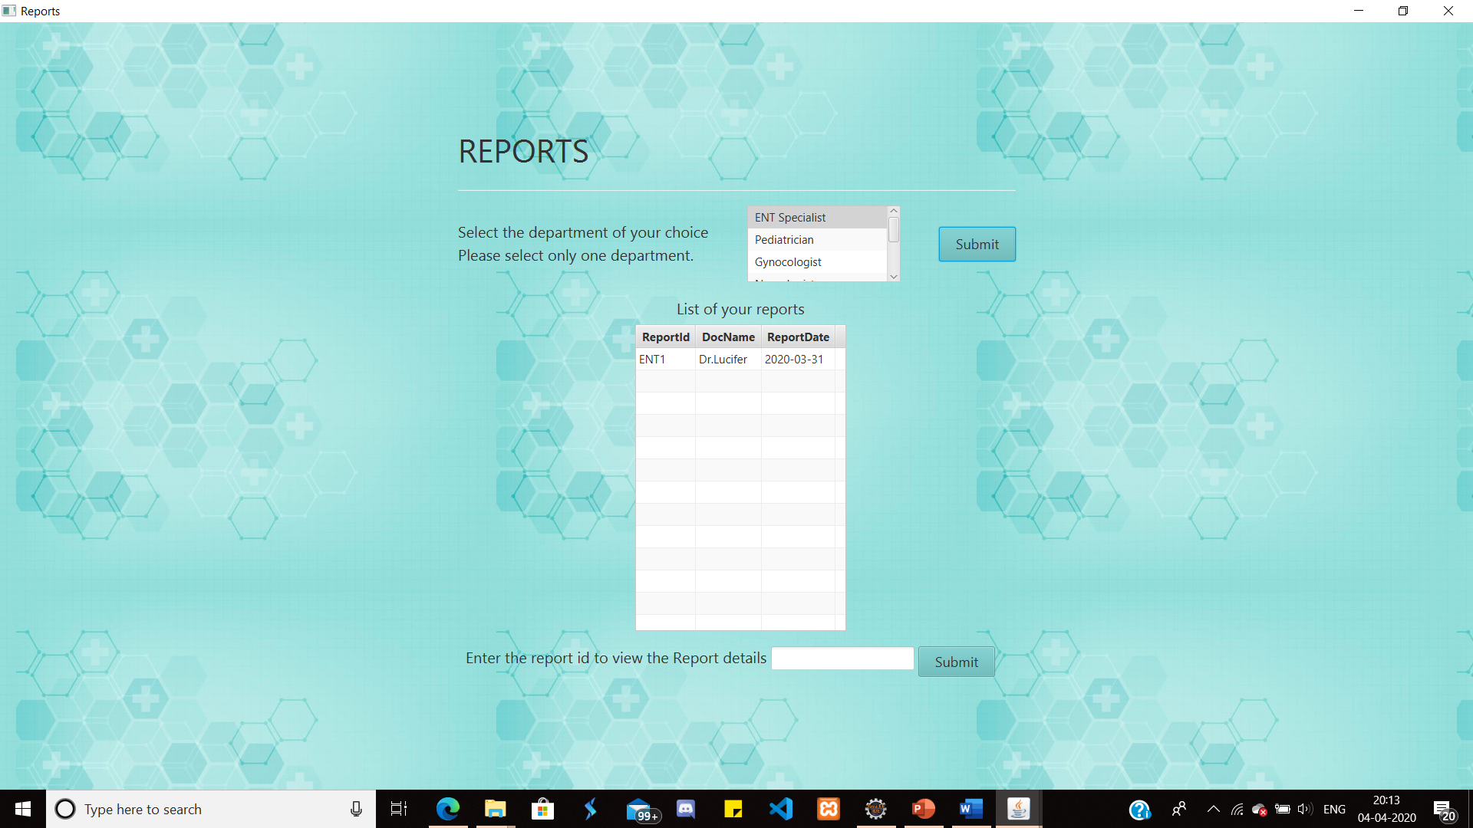
REPORTS MAIN SCREEN

Slide 17

REPORTS

Slide 18
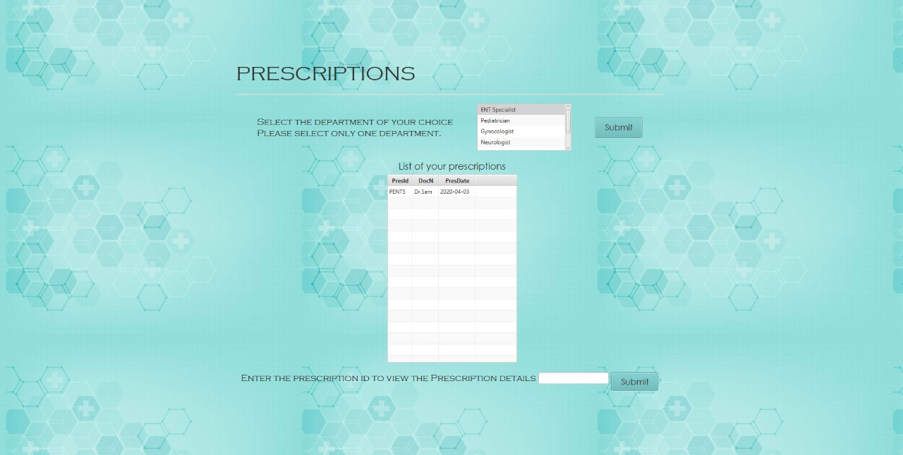
PRESCRIPTIONS MAIN SCREEN

Slide 19
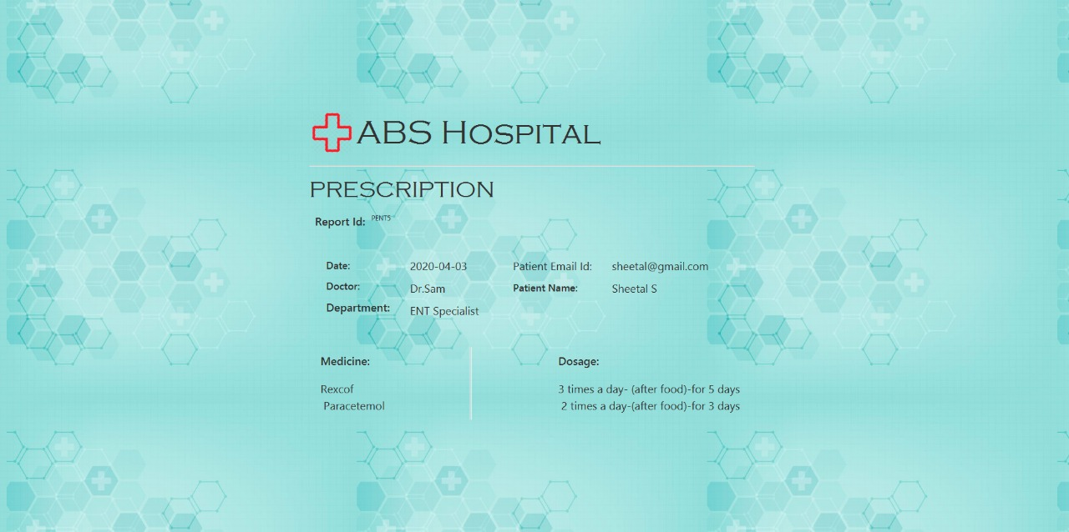
PRESCRIPTION

Slide 20
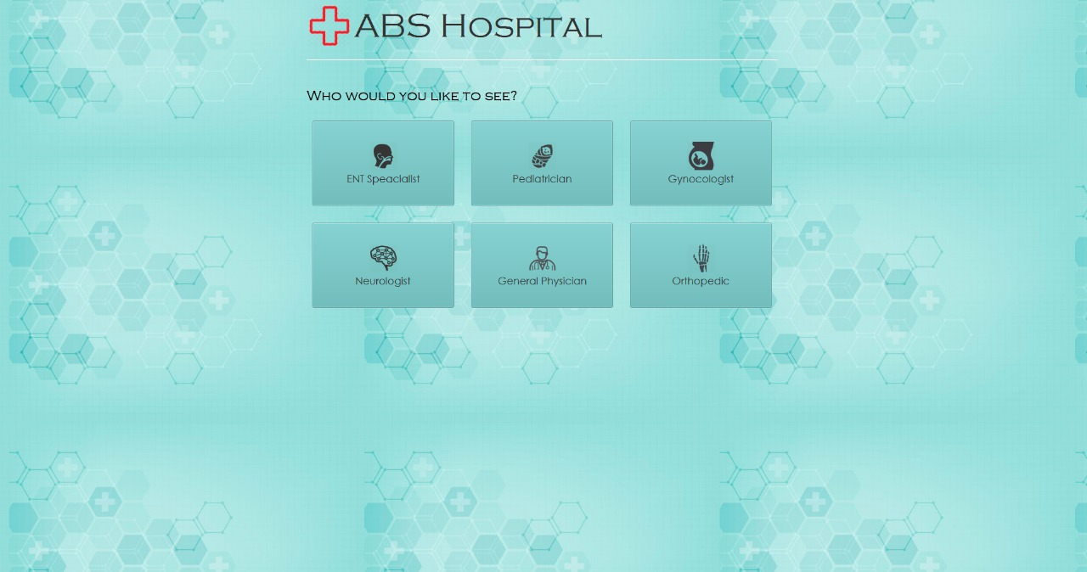
BOOK AN APPOINTMENT

Slide 21
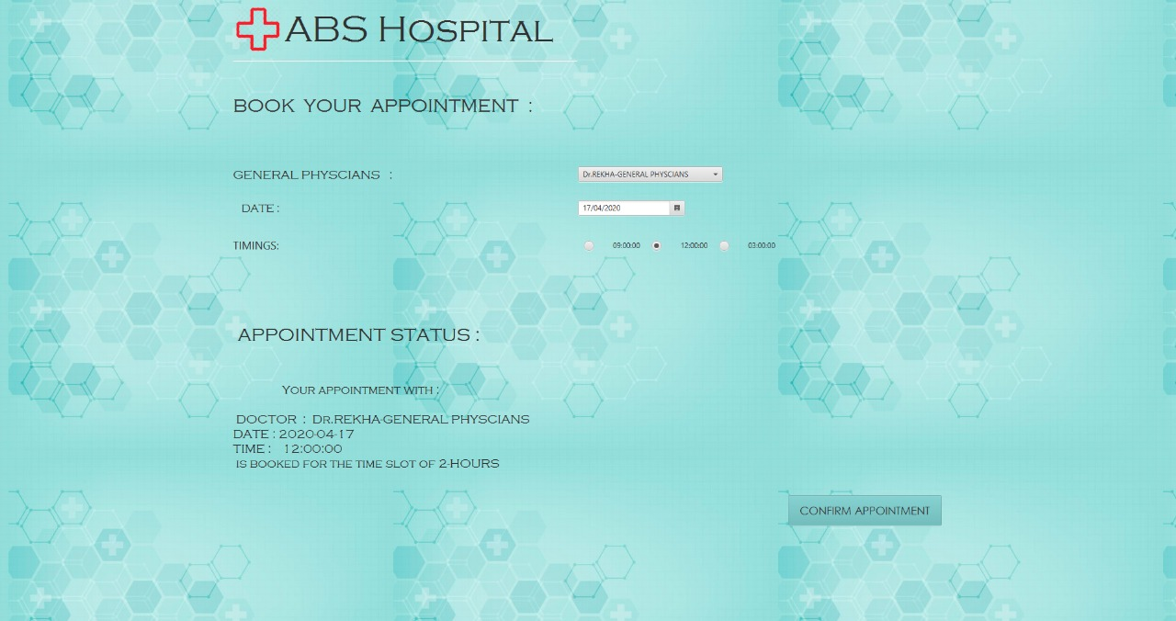
BOOK AN APPOINTMENT

Slide 22
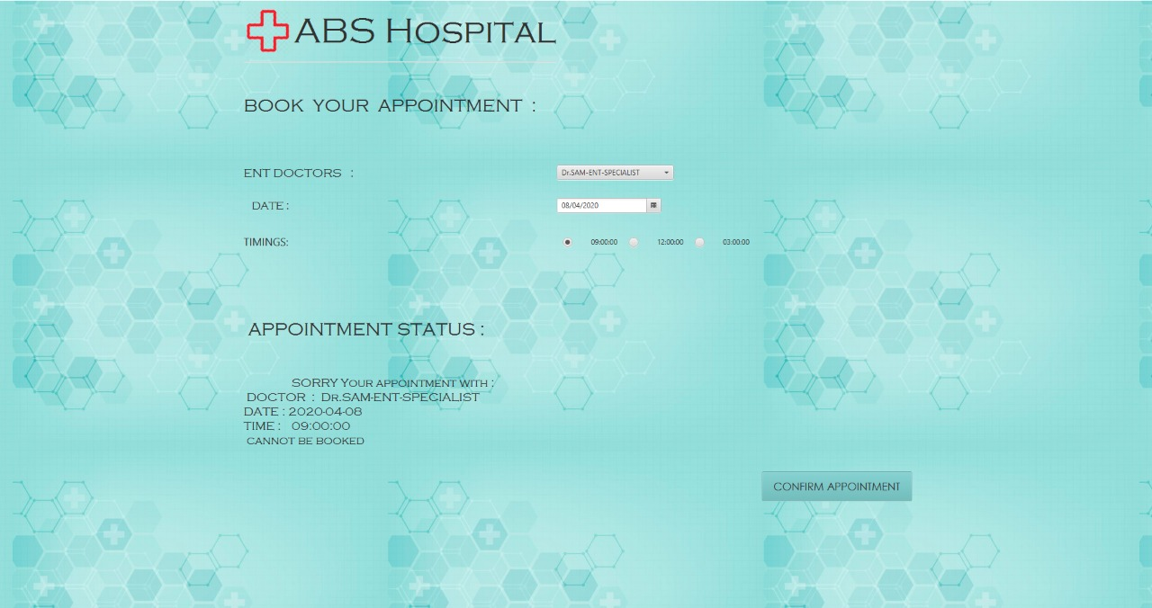
BOOK AN APPOINTMENT

Slide 23
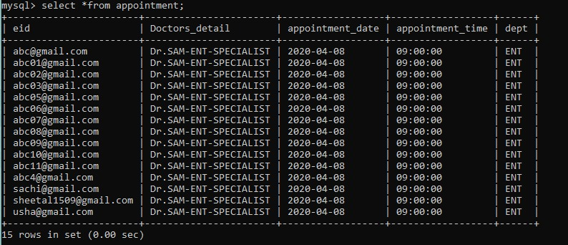
BOOK AN APPOINTMENT

Slide 24
REFERENCES
https://docs.oracle.com/javase/8/javafx/api/toc.htm
https://www.tutorialspoint.com/jdbc/jdbc-statements.htm

